Slide 1


Green Pace
Security Policy Presentation
Developer: Hillary Loyd
SNHU CS-405

Slide 2

OVERVIEW: DEFENSE IN DEPTH
The introduction of this security policy is to help standardize principles and coding standards aspects at Green Peace. Best security practices have been included, things such as Defense in Depth and a Triple-A Framework.

Slide 3
THREATS MATRIX
Likely Threats that are very likely to happen. | Priority A standard with a high relevancy and will need attention.
Low priority A standard with a low relevancy. | Unlikely Threats that are less likely to happen.
The standards of Secure Coding do come with a level of vulnerability. This will measure the impact of a certain standard. This chart prioritizes the levels for the policy that will be used for Green Peace.

Slide 4
10 PRINCIPLES
1. Validate Input Data
2. Heed Compiler Warnings
3. Architect and Design for Security Policies
4. Keep it Simple
5. Default Deny
6. Adhere to the Principle of Least Privilege
7. Sanitize Data Sent to Other Systems
8. Practice Defense in Depth
9. Use Effective Quality Assurance Techniques
10. Adopt a Secure Coding Standard

Slide 5
CODING STANDARDS
STD-003-CPP: String Correctness-Do not attempt to create a std::string from a null pointer.
STD-004-CPP: SQL Injection-Honor replacement dynamic storage management requirements.
STD-005-CPP: Memory Protection-Properly deallocate dynamically allocated resources.
STD-007-CPP: Exceptions-Honor exception specifications.
STD-002-CPP: Data Value-Use Valid pointers, references, and iterators to reference elements in a container.
STD-009-CPP: Input/Output-Do not alternately input and output from a file stream without an intervening positioning call.
STD-001-CPP: Data Type- Do not cast to an out-of-range enumeration value
STD-008-CPP: Expressions-Do not delete an array through a pointer of the incorrect type.
STD-010-CPP: Object Oriented Programming (OOP)-Honor replacement handler requirements.
STD-006-CPP: Assertions-Use a static assertion to test the value of a constant expression.
The above are ranked from highest to lowest based on the priority level.
Rule | Severity | Likelihood | Remediation Cost | Priority | Level
STD-001-CPP | Medium | Unlikely | Medium | P4 | L3
STD-002-CPP | High | Probable | High | P6 | L2
STD-003-CPP | High | Likely | Medium | P18 | L1
STD-004-CPP | High | Likely | Medium | P18 | L1
STD-005-CPP | High | Likely | Medium | P18 | L1
STD-006-CPP | Low | Unlikely | High | P1 | L3
STD-007-CPP | Low | Likely | Low | P9 | L2
STD-008-CPP | Low | Unlikely | Medium | P2 | L3
STD-009-CPP | Low | Likely | Medium | P6 | L2
STD-010-CPP | Low | Probable | High | P2 | L3

Slide 6
ENCRYPTION POLICIES
Encryption
In Rest - Encryption at rest is the process of securely encoding data as it is written into storage and decrypting that data as it is pulled from storage for use. This will help prevent an attacker from accessing the unencrypted data.
At Flight - Encryption of data in-flight is the process of securely encoding data as it is being transmitted. Depending on the how the data will be transferred will depend on the type and application of the encryption that will be needed. A web browser will always use secure protocols, however, something like email is encrypted prior to sending it.
In Use - Encryption of data in-use is the process of protecting data as it is utilized in memory. Someone with access to random access memory could parse the memory and locate the encryption key used for the data at rest. After obtaining that key they could decrypt that data.

Slide 7
TRIPLE-A POLICIES
Triple-A Polices
Authentication - Authentication is the process where the user is being confirmed as someone who has access to the system. This can be done with things like user login, passwords, possibly higher-level security such as secure tokens, PIN, 2 step authentication and other hardware credentials.
Authorization - Authorization is the level of access that a user has within the system. The user would be able to read, create, modify, or delete file within the database depending on the access that is authorized.
Accounting - Accounting is the process of monitoring what a user is doing with their level of access to the system. This keeps track of the databases that are being accessed, who accessed those database, and what the user did to the database.

Slide 8
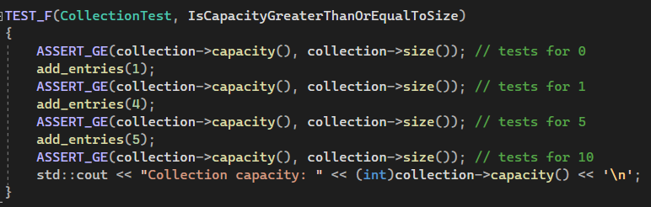
Unit Testing: Is the Capacity Greater than or Equal to size?
Unit testing should start early as well as often throughout the SDLC. This will ensure that the code is secure and functioning the wat that it was intended to.
Ex: Testing to make sure the capacity for collection is greater than or equal to the size of collection.

Slide 9
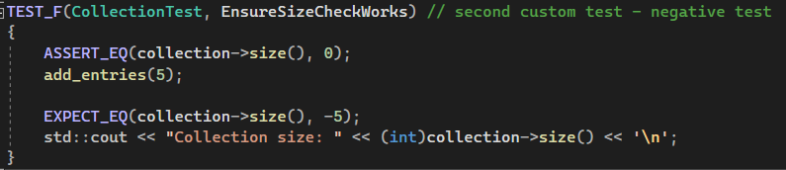
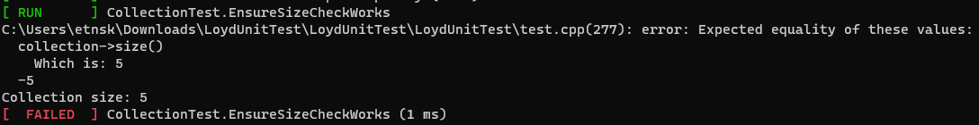
Unit Testing: Are the size checks working?
Ex: Testing to make sure that the collection size checks are working.
This test was intended to be negative which is why it is a Failed test.

Slide 10
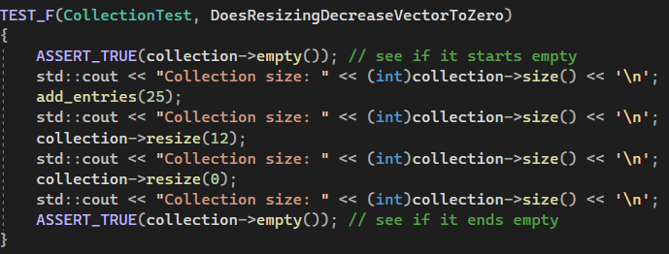
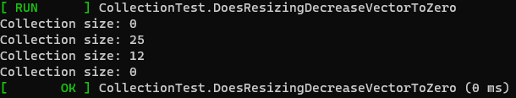
Unit Testing: Does Resizing Decrease the Vector to Zero?
Ex: Testing to see is resizing of the collection will decrease the vector to zero.

Slide 11
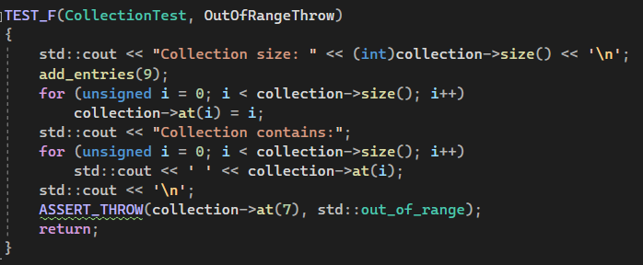
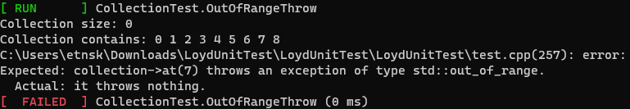
Unit Testing: Is the Out-of-Range Throw verified?
Ex: Testing to verify that if the collection size is out of range, then the system will execute the ASSERT_THROW.
This test was intended to be negative which is why it is a Failed test.

Slide 12

AUTOMATION SUMMARY

Slide 13
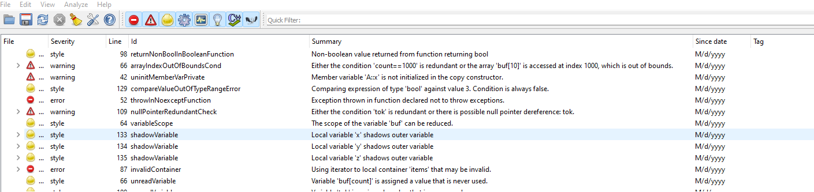
TOOLS
DevSecOps Pipeline – This is the process of integrating security into the software development life cycle(SDLC) from creation to postproduction. This method of secure coding has the same full circle approach that enforces a policy to have an infrastructure that is built with the mindset of keeping the code secure.
Tools – External tools, like Cppchecker and IDE testing are a way to detect warnings and errors through the process of execution of the code. These tools should be used throughout the process of development to ensure the secure coding is taking place. Below is an example of Cppchecker.

Slide 14
RISKS AND BENEFITS
Now
Risk – Due to multiple test that will have to be conducted on sections of the code prior to being implemented into the main code, this will take an extended amount of time.
Benefits – Keeping in mind secure coding standards, practices and policies will help keep a more secure project. The testing will be consistent throughout the project and help discover the warnings and errors that will need to be acted upon during this process.
Wait
Risk – Waiting will create code that may not be compatible with secure features, more unsecure code during the process that will have to be address all at the end, the potential of going over budget or due date, and the chance of hurting the reputation of the consumer and the developer.
Benefit – Faster development of the code in the SDLC.

Slide 15
RECOMMENDATIONS
External tool to run vulnerabilities
Unit Testing
Developers
Triple-A Framework
Encryption

Slide 16
CONCLUSIONS
For the best protection it is best to always use the secure coding practices and standards. The way that technology in the world is going, this type of protection is very important. Taking the extra steps from the beginning of the SDLC, implementation of Defense in Depth, and making testing a common practice will help allow the DevOps to change into a DevSecOps at Green Peace. Having everyone adopt the standards to improve the security of systems and the applications is something that must be done to help make this goal succeed.

Slide 17
REFERENCES
Confluence. SEI External Wiki Home - Homepage - Confluence. (n.d.). Retrieved February 18th, 2023, from https://wiki.sei.cmu.edu/confluence/.

